Slide 1




Slide 2

Bash Scripting

Slide 3

Workshop plan
Introduction
Variables && Parameters
Decision
Repetition
Arithmetic operations
Special features

Slide 4


Introduction
What is Bash?
The Bourne-Again Shell is a command interpreter and a high-level
programming language. As a command interpreter, it processes
commands you enter on the command line in response to a prompt.
And as a programming language, it processes commands stored in
files called shell scripts.
Why script with Bash?
Automate repetitive and time-consuming tasks
Preferred tool for system administration
Powerful utility when it comes to I/O communication
It’s the glue logic that makes small general purpose tools work together

Slide 5
Introduction
Example Bash script
#!/bin/bash
# This is a comment echo "Hello World!"
How to run a script?
$ chmod +x script.sh $ ./script.sh Hello World!

Slide 6
Variables
Assign a value to a variable
Environment variables
$ varname=value # No spaces!
$USER : current user
$HOME : home directory
$PATH : paths where to find programs
Print the value of a variable
$ echo $varname
Read user input
$ read -p "prompt: " varname

Slide 7
Special variables
Parameter | Meaning
$0 | Name of the current shell or shell script
$1-$9 | Positional parameters 1 through 9
$# | Number of positional parameters
$* | All positional parameters (as one string)
$@ | All positional parameters (as a set of strings)
$? | Returns status of last command
$$ | Process ID of current shell or shell script
$(command) | Output of command after execution

Slide 8
Positional parameters
$ ./script.sh apple banana orange
$0 : "./script.sh"
$1 : "apple"
$2 : "banana"
$3 : "orange"
$# : 3
$* : "apple banana orange"
$@ :
"apple"
"banana"
"orange"

Slide 9
Decisions
if-then (syntax)
Example
if command; then # statements fi
if cd /tmp; then echo "I am in temp directory" fi
if-then-else (syntax)
Example
if command; then # statements-1 else # statements-2 fi
if which $cmd; then echo "$cmd is available" else echo "$cmd isn't available" fi

Slide 10
Decisions
test command
test expression # or [ expression ]
Evaluates expression and returns either 0 (success) or 1 (failure)
Example 1
Example 2
if test "$1" = search; then echo "You chose the search option" fi
if [ -e "$file" ]; then echo "file $file exists!" fi

Slide 11
Test operators
Operator | Meaning
-n STRING | Length of STRING is nonzero
-z STRING | Length of STRING is zero
STRING1 = STRING2 | Strings are equal
STRING1 != STRING2 | Strings are not equal
-e FILE | FILE exists
-f FILE | FILE exists and is a regular file
-d FILE | FILE exists and is a directory

Slide 12
Repetition
for loop (1st syntax)
Example
for varname in arguments; do # statements done
for fruit in apple banana orange; do echo "Fruit: $fruit" done
for loop (2nd syntax)
Example
for (( INIT; TEST; STEP )); do # statements done
for (( i=0; i < 10; i++ )); do echo "i = $i" done

Slide 13
Repetition
while loop
while command; do # statements done
Example 1
Example 2
while read line; do echo $line done
while [ "$password" != secret ]; do read -p "password: " password done

Slide 14
Arithmetic operations
Use let or (( )) for arithmetic operations on integers
$ let n=10 $ (( n += 2 )) $ echo $n 12 $ let n++ $ echo $n 13 $ echo $((n*2)) 26

Slide 15
Special features
Feature | Example syntax | Meaning
Brace expansion | file{1,2,3}.txt | Expands to: file1.txt file2.txt file3.txt
Brace sequence expansion (Numbers) | {1..5} | Expands to: 1 2 3 4 5
Brace sequence expansion (Letters) | {a..d} | Expands to: a b c d
Variable Indirection | ${!varname} | The value of varname is used as the name of the variable to resolve

Slide 16
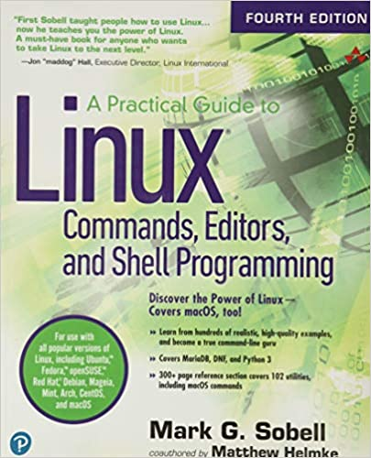


Resources
A Practical Guide to Linux Commands, Editors, and Shell Programming 4th Edition – Mark G. Sobell
Luke Smith - Bash, Shell and UNIX Chaddery
Google

Slide 17
Challenges here
Thank you!

